Slide 1
September 2023 Webinar
HOW DO WE CHOOSE A CAREER?

Slide 2
The National Stuttering Association (NSA)
is a non-profit organization dedicated
to bringing hope and empowerment to adults and children who stutter, their families, and professionals, through support, education, advocacy, and research.
www.WeStutter.org

Slide 3
The WE STUTTER @ WORK program from the National Stuttering Association is all about helping people who stutter achieve career success through Practice Online Job Interviews, Webinars, Career Profiles, and Employer Education.
www.WeStutter.org/CareerSuccess

Slide 4
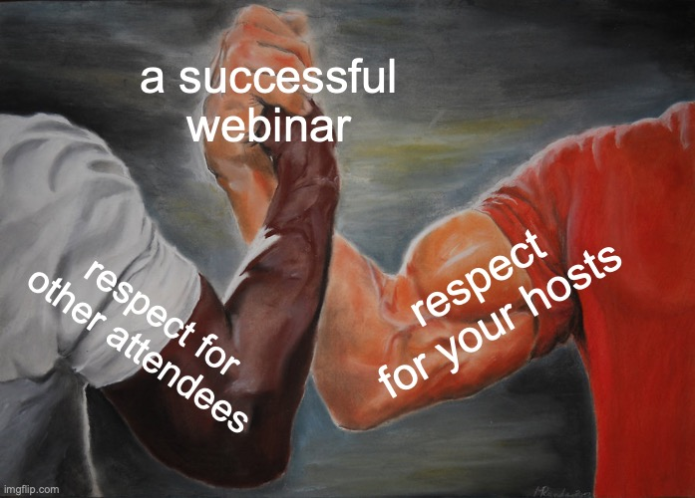
Webinar Guidelines
✅ Please stay on mute during presentation
✅ For questions/comments, please use the chat function
✅ We will let you know when recording is available
Please be respectful to ensure that we all have the best experience possible!

Slide 5
Webinar Host
Anabel Augustin

Slide 6
Webinar Participants
Ashleigh Givens
Fashion photographer, creative director, and multimedia artist currently residing in Detroit Michigan. Ashleigh is a recent graduate of the college for creative studies, and is currently freelancing for political campaigns, fashion startups, and modeling agencies. Ashleigh likes to stay active in the NSA community being a former member of TAC and currently is on the DEI committee.
Ben North
An associate attorney and Title IX advisor at Binnall Law Group in Alexandria, Virginia. Ben has represented students and faculty in state and federal litigation, and also within the Title IX process at private and public K-12 schools and universities. Ben has argued cases before numerous state and federal courts, the United States District court for the Western District of Virginia, Virginia and Louisiana state courts, and the United States District Court for the District of Maryland. Ben is a member of the
NSA and currently serves as the NSA Young Adult Committee Chair.

Slide 7
HOW DO YOU CHOOSE A CAREER?
Your passion & skills- what do you love to do? what inspires you? what are you good at?
Your Goals- what do you want out of your career the most? what is important to you in a career (salary/benefits/growth opportunities)?
Talk to family members/friends/professionals in various career fields- get different opinions about pro/cons of different jobs, search job requirements, and make a list of careers to explore.
Assess yourself- self assessment tools/ career tests/personality assessment test as an indicator of what career field could be a good fit.

Slide 8
HOW DO YOU EXPLORE A CAREER?
Career fairs in the community or at a college
Complete self assessment tests/personality tests
Paid/unpaid internships
Make a list of transferable skills
Research career options
Have informational interviews with parents/other family members, friends or professionals

Slide 9
HOW DOES STUTTERING AFFECT CHOOOSING A CAREER?
Holding back due to fear of being judged.
Fear of not being successful in our career fields.
Fear of not being able to demonstrate being confidence and competence for the job.

Slide 10
HOW DOES STUTTERING IMPACT YOUR CHOICES?
Avoiding jobs in the communications field
Decreased chances of taking leadership roles in career fields
Fear of not being promoted or hired for a specific role
Decreased chances of taking on more challenges

Slide 11
HOW DOES STUTTERING IMPACT YOUR CHOICES?
Affects directly a person’s academic choices and career prospects
Fear of being seen as incompetent and having low self esteem
Common stereotypes of being nervous, shy, and insecure

Slide 12
Q&A time
Let’s hear from our participants.

Slide 13
www.WeStutter.org/CareerSuccess

